Slide 1
Food Insecurity in the USA
A Domestic Crisis fuelled by Household Structure, Education and Income Inequality.
By Pricilla Nakyazze

Slide 2
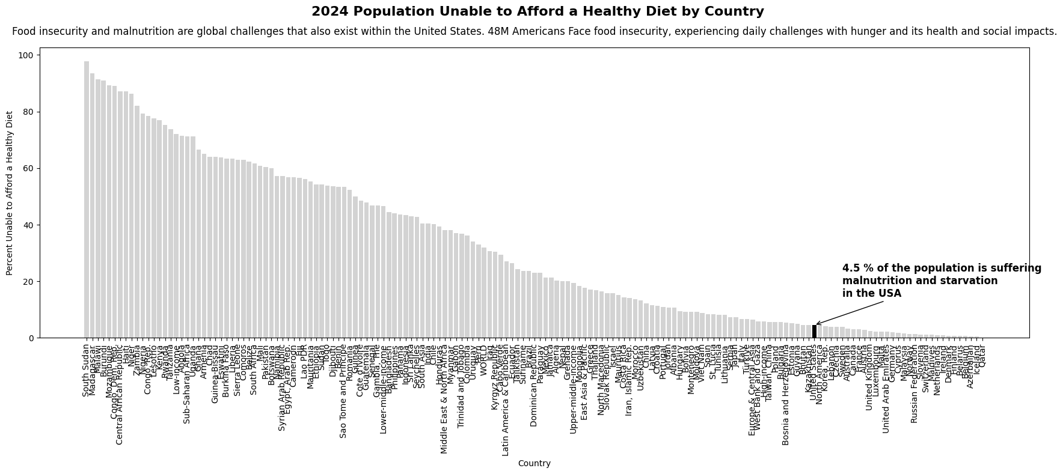
Where does the problem of Food insecurity exist?
Data from database: Food Prices for Nutrition

Slide 3
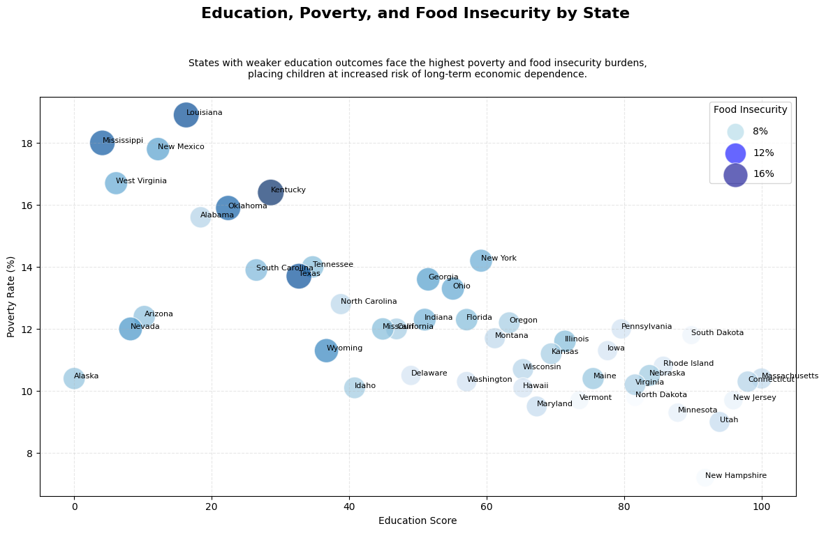
Where are food insecurity and poverty most concentrated in the US?
Data source:Americadashboard, Usda.gov

Slide 4
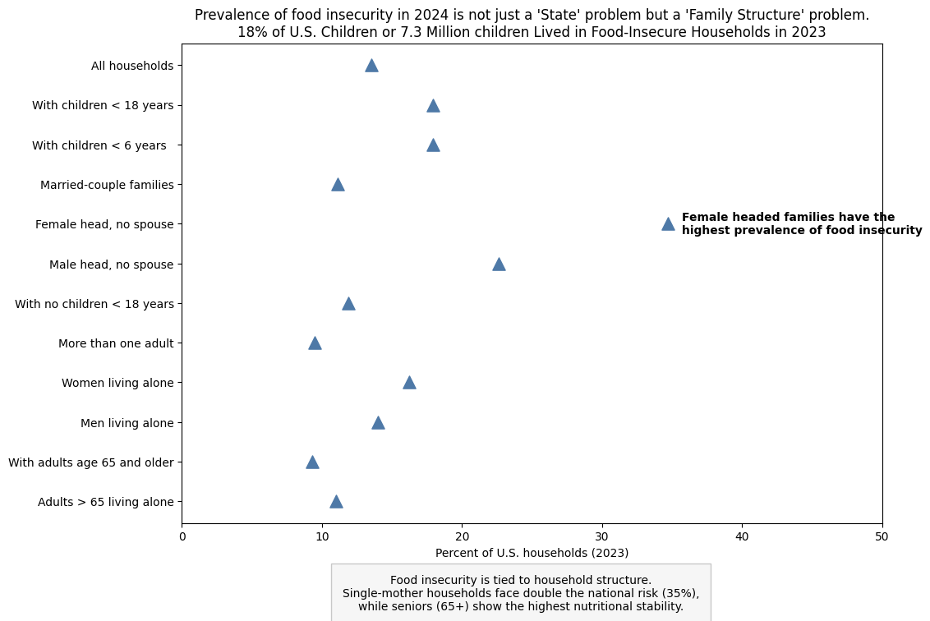
Which households are most vulnerable to food insecurity, and where should public policy interventions be targeted first?
Usda.gov statistics

Slide 5
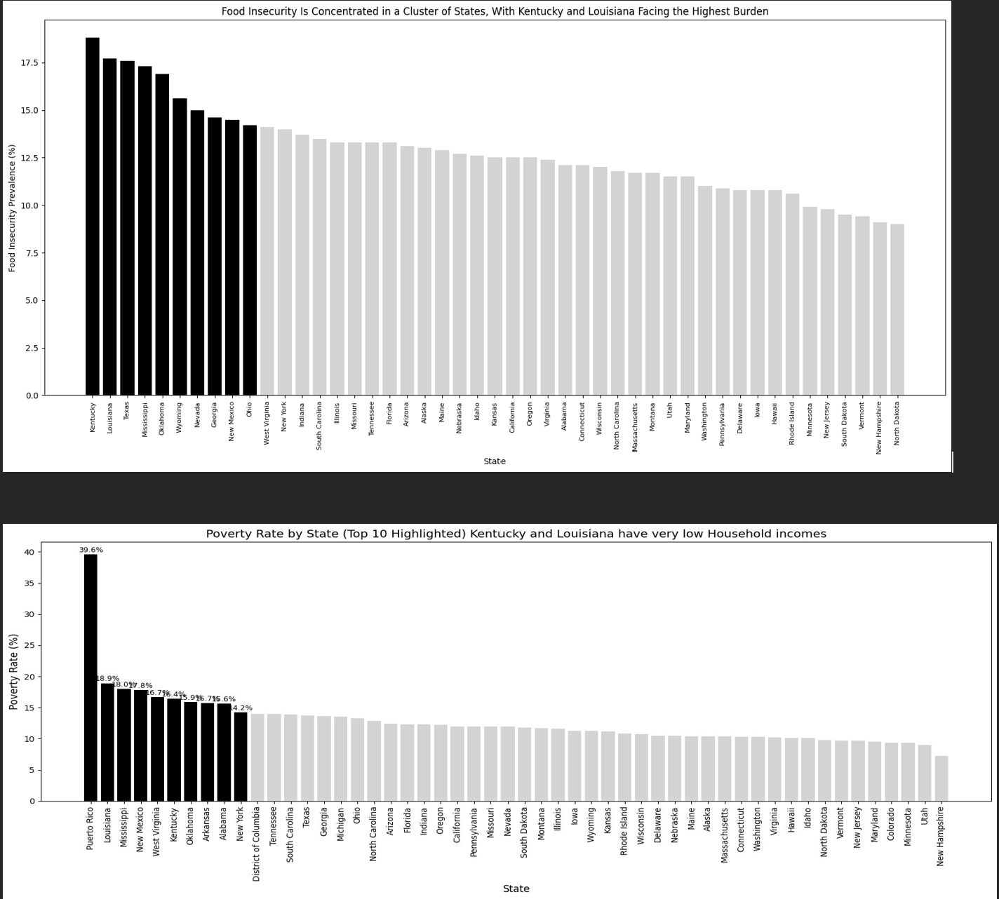
How strongly is food insecurity concentrated in states with the highest poverty rates?

Slide 6
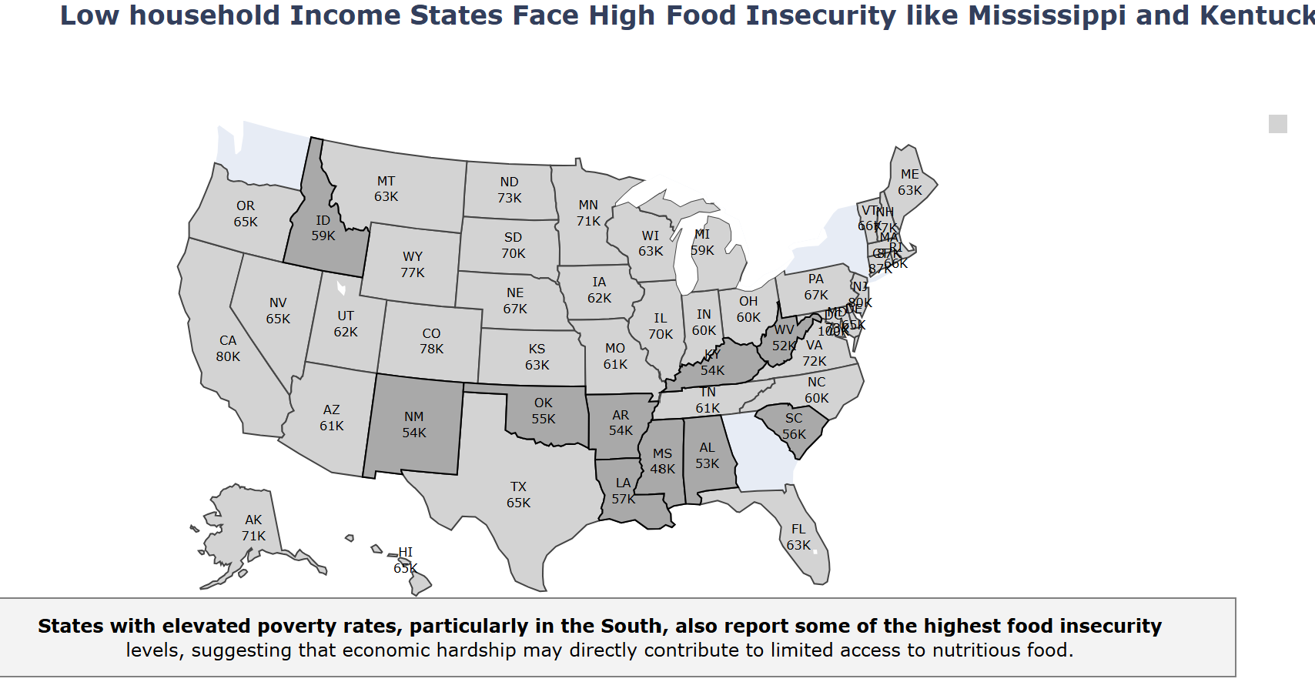
Do states with the highest poverty rates also experience the highest food insecurity, indicating a structural link between economic hardship and access to nutrition??

Slide 7
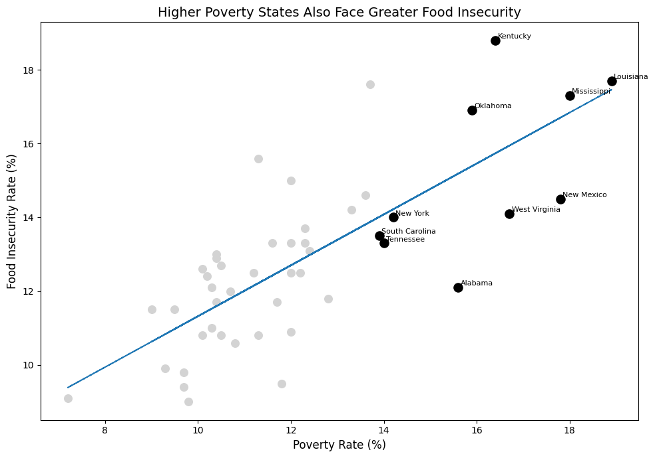
Do correlations exist between level of poverty and food insecurity, malnutrition and starvation?

Slide 8
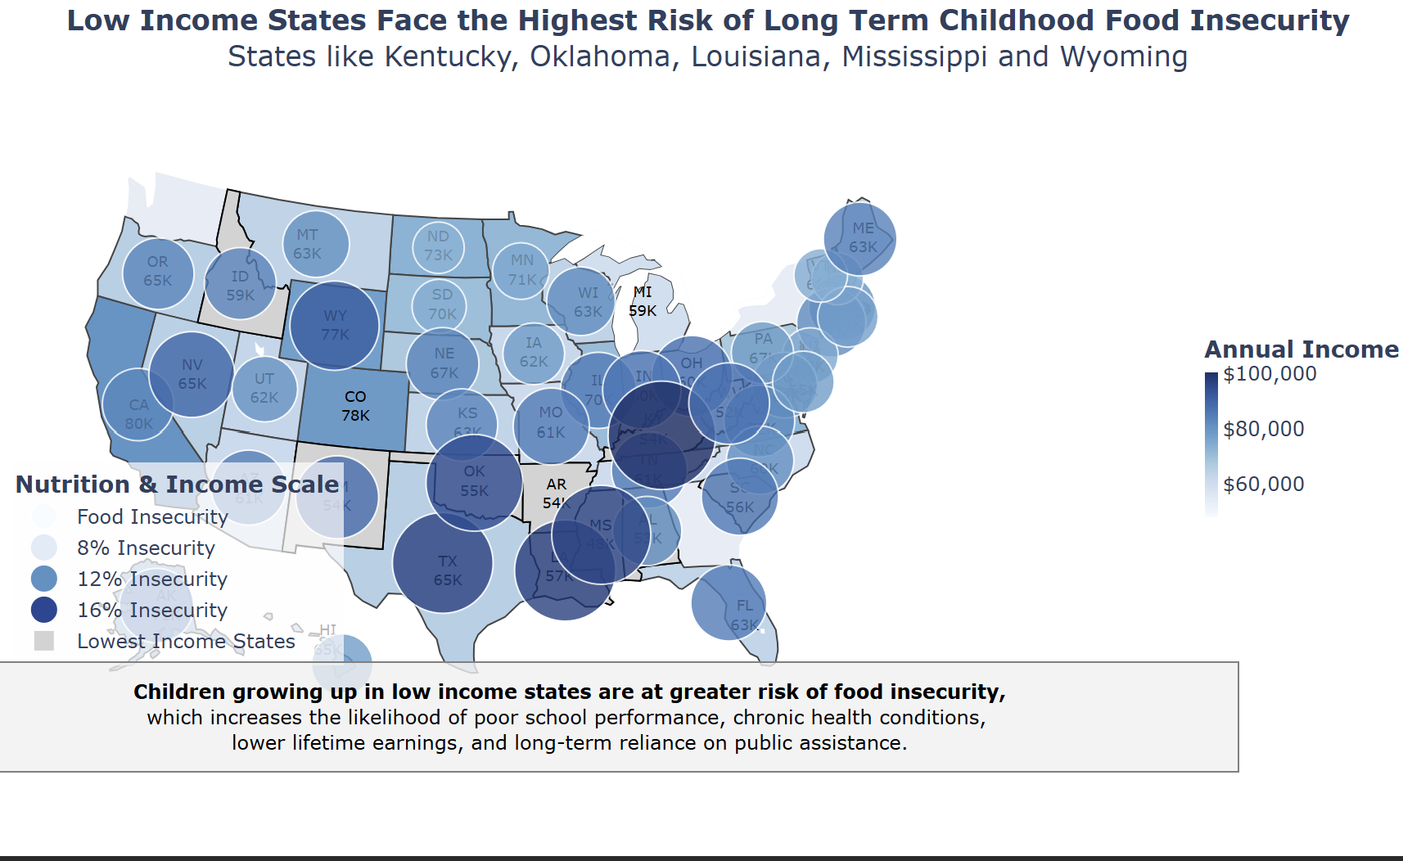
What happens if these children grow into adulthood without intervention?

Slide 9
Data Sources
Source: Food Prices and Nutrition, World Bank Databank. Click on a metadata icon for original source information to be used for citation.
https://databank.worldbank.org/source/food-prices-for-nutrition#
source for education: https://americadashboard.com/rankings/education
https://www.ers.usda.gov/topics/food-nutrition-assistance/food-security-in-the-us/key-statistics-graphics
https://www.fns.usda.gov/research/nutrition-education-coordination-report-congress-fy-2022
https://en.wikipedia.org/wiki/List_of_U.S._states_and_territories_by_income

